Slide 1
IL21 new plot

Slide 2
How the YAA locus in BXSB mice accelerates SLE developing?

Slide 3
Facts, questions, and approaches
What we know?
YAA mutation was identified to be a translocation from the telomeric end of the X chromosome onto the Y chromosome
YAA locus contains Tlr7 gene, but the exact genomic range is unclear
The accelerated development of SLE in male BXSB mice is associated with the genetically abnormal YAA locus in its Y chromosome
BXSB mice with a B6 Y chromosome do not develop the disease
C57BL/6J mice carrying the YAA gene are indistinguishable from wild type controls
What we have?
B6 and BXSB genome (Steve Munger)
RNA-seq on wild type BXSB and BXSB with B6 Y chromosome
Microarray on wild type B6, and B6 with BXSB Y chromosome
Differential genes, GO, KEGG, and master regulators
What are the questions and how to approach?
What are the genomic differences between BXSB and B6 that are functional?
How to refine the YAA locus?
How to infer a model from the differential genes between BXSB and BXSB^{B6(Y)} in terms of protein cascade?
How the BXSB background cooperate with the extra YAA locus on Y chromosome to accelerate SLE development?
Identify the differential genes between BXSB WT and B6 with BXSB Y chromosome
Integrate the IL21 data or not? How?

Slide 4
BXSB vs BXSB^{B6Y} and B6^{BXSBY} vs B6
2403 and 2694 up and down genes from BXSB to BXSB^{B6Y}
262 and 725 up and down genes from B6^{BXSBY} to B6
What does each of the gene group mean?
BXSB
BXSB^{B6Y}
B6^{BXSBY}
B6

Slide 5
BXSB is the only SLE-causing
2167 up genes are SLE-causing.
100 + 74 genes are SLE-protecting.
BXSB
BXSB^{B6Y}
B6^{BXSBY}
B6

Slide 6
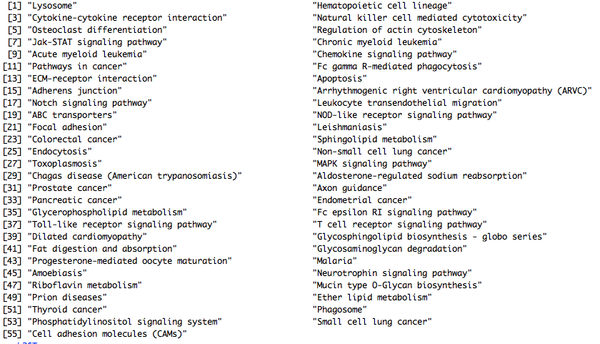
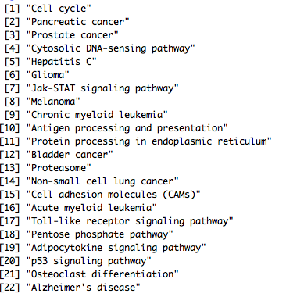
BXSB is the only SLE-causing

Slide 7
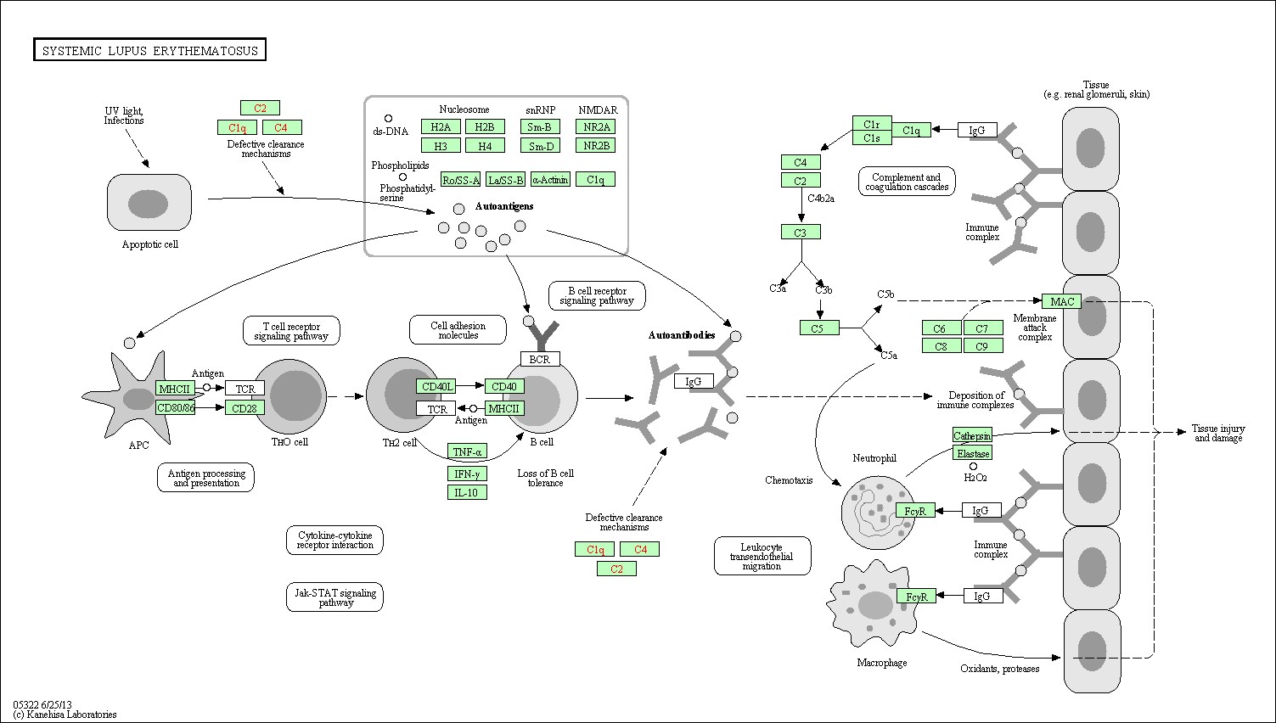
KEGG: SLE

Slide 8
IL21 signaling?
 | IL21^{N}ICOS^{N} | IL21^{N}ICOS^{P} | IL21^{P}ICOS^{P}
BXSB^{B6} | 190*** | 100 | 68
BXSB^{YAA} | 43 | 193 | 217***
Fisher’s test: p value equals 2.2e-16
Chi-square test: p values equal 6.613e-12 and 1.52e-13 for BXSB^{B6} and BXSB^{YAA}

Slide 9
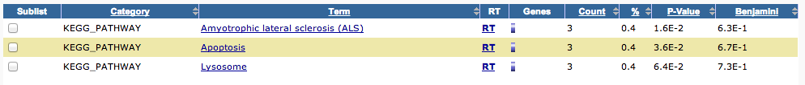
IL21 signaling?
 | IL21^{N}ICOS^{N} | IL21^{N}ICOS^{P} | IL21^{P}ICOS^{P}
B6^{B6} | 24 | 7 | 13
B6^{YAA} | 30 | 64 | 73***
Fisher’s test: p value equals 9.774e-06
Chi-square test: p values equal 0.006294 and 9.712e-05 for B6^{B6} and B6^{YAA}

Slide 10
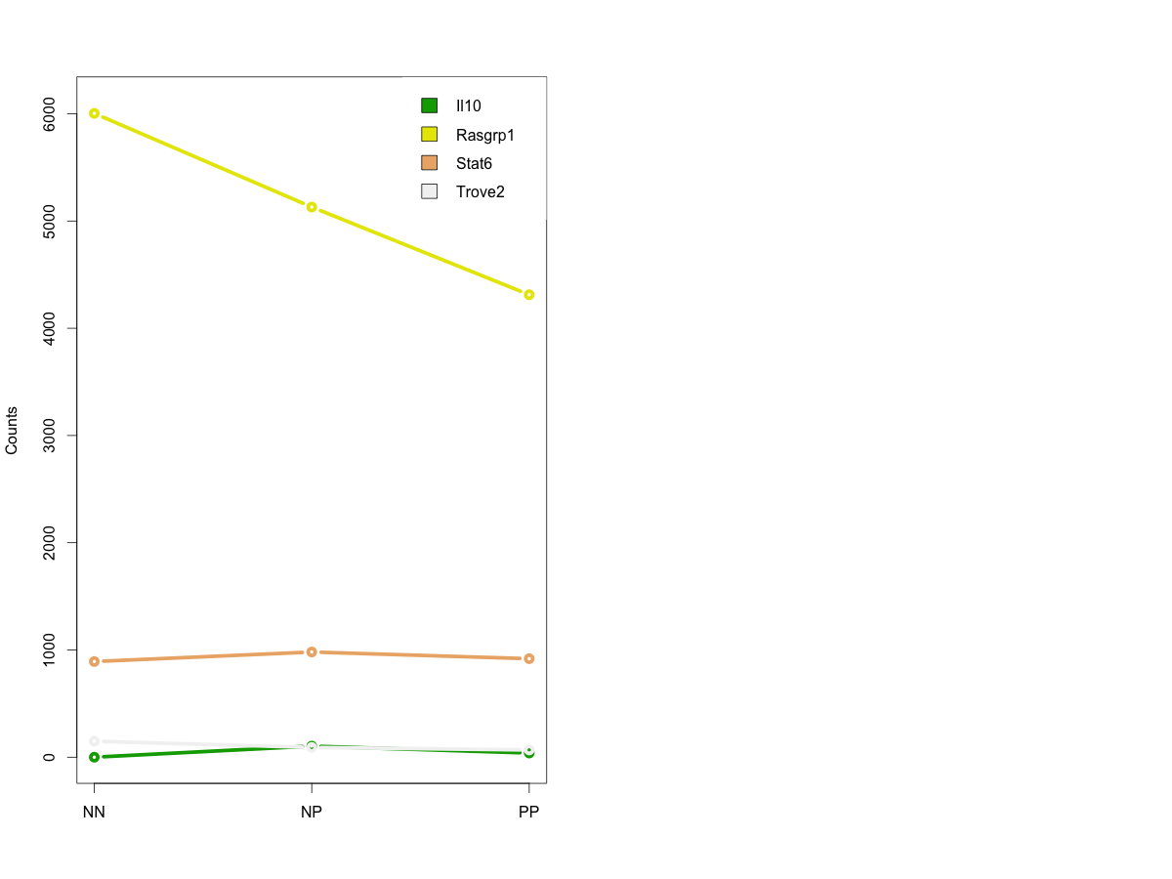
GWAS/MGI hints
Rasgrp1 appears as significant in both Il21 and BXSB experiments, with the same trend

Slide 11
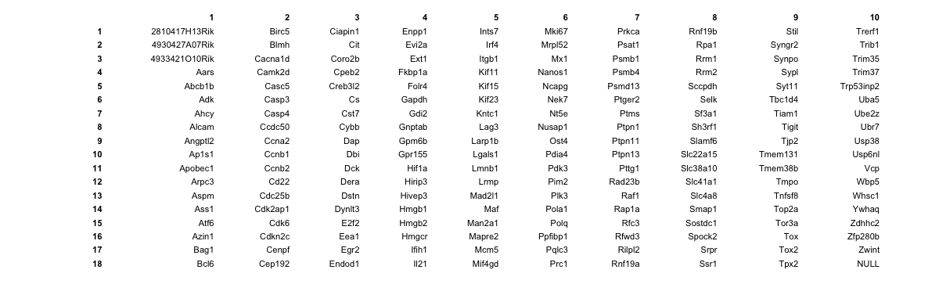
BXSB^{B6/YAA} and IL21

Slide 12
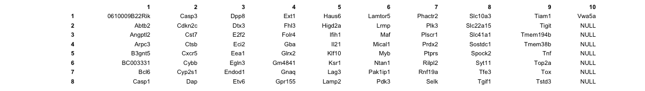
B6^{B6/YAA} and IL21

